Slide 1

An Analysis of Major League Baseball’s World Series Winners
Tucker Atwood
WGU MSDA

Slide 2
Contents
Introduction
Hypothesis
Analysis
Findings
Limitations
Actions
Benefits

Slide 3

Introduction
My name is Tucker Atwood, and I am a student in the Master’s of Science in Data Analytics program at Western Governors University. At some crucial point in my childhood development, I was introduced to baseball and, more importantly, baseball statistics. The ensuing obsession has dictated the rest of my life and set me on the path that eventually led me to this program. I hope to continue this path into the world of sports analytics, where millions of dollars are spent each year in endless attempts to become champions. That is where this particular project begins.

Slide 4

Hypothesis
In Major League Baseball (MLB), 12 teams out of 30 qualify for the playoff tournament at the end of the season. Qualifications are given based on performance in a 162-game regular season schedule, but playoff series consist of at most 7 games.
Over the course of 162 games, a team’s true talent level is usually apparent, as the large sample size allows regressions to the mean. Once the playoffs begin, however, the small sample size gives power to the quirks of randomness, and it is significantly more difficult to predict which teams will be victorious.
MLB Regular Season | MLB Playoffs
162 Games | Up to 7 Games Per Series
30 Teams | 12 Best Teams
True Talent Levels are Apparent | Randomness Galore!

Slide 5

Hypothesis (cont.)
With millions of dollars on the line, there is a long-standing debate about whether specific player types and strategies are more important to playoff success than regular season success.
On offense, should teams prioritize contact hitters, power hitters, or patient hitters? And how much should they sacrifice good offensive talent to ensure decent speed or defensive ability?
On defense, which pitchers should be targeted: those who strike out batters at the expense of giving up walks, or those who can control the strike zone and limit the quality of contact their opponents make?

Slide 6
Hypothesis (cont.)
My hypothesis in this analysis is that there is a significant difference in at least one factor (measured with commonly used baseball statistics) between Major League Baseball teams that win the World Series and other playoff teams who do not.

Slide 7

Analysis
To test my hypothesis, I used hypothesis tests. Seems like the correct technique choice just from the name, right? Here’s what happens in a hypothesis test like the ones I ran:
The averages and standard deviations (a measurement of how “spread out” data is) in a chosen statistic are calculated for two different groups. In this analysis, those groups were:
Teams that won the World Series.
Other teams that did not.

Slide 8

Hypothesis Test Description
The averages and standard deviations are compared to determine if there is a statistically significant difference between them.
To determine significance, a hypothesis test starts by assuming that there is no difference.
It then calculates the probability of getting the given results, or more extreme, if that assumption was true.
If this probability is very low, past a certain pre-determined threshold, this is considered enough evidence to say that the original assumption was not true.

Slide 9

Hypothesis Test Example
You are trying to show that one baseball team is better at scoring more runs per game than another team.
You assume that both teams can score the same number of runs per game.
Using the averages and standard deviations of collected runs scored statistics, you show that if the two teams were equal in talent, results as extreme as those found would only occur 1% of the time.
This percentage is lower than your pre-determined threshold for significance, so you say once and for all: this team is better!

Slide 10
Yearly League Average Adjustment
Year-adjusted value | Assessment
Below 100 | Less than league average in that season
100 | League average in that season
Above 100 | Greater than league average in that season
To adjust for historical changes in strategies, rules, and trends, all statistics have been adjusted so that they are expressed in relation to the season’s average. This allows statistics from different eras to have similar weights and to be compared easily.
As a result, all statistics can be assessed with the following considerations:

Slide 11
Offensive Statistics Tested
Stat: | Abbreviation: | Description:
Batting Average | AVG | Safe hits per at-bat.
On-base Percentage | OBP | Percentage of plate appearances reaching base safely.
Slugging Percentage | SLG | Batting average adjusted for extra-base hits (doubles, triples, home runs).
On-base Plus Slugging Percentage | OPS | OBP + SLG. Provides more information that either of the two other stats do separately.
Runs Per Game | RPG | Runs scored per game.
Batter Walk Rate | BBr | Percentage of plate appearances with a walk (BB = Base on Balls).
Batter Strikeout Rate | Kr | Percentage of plate appearances with a strikeout (K = Strikeout).
Batter Home Run Rate | HRr | Percentage of plate appearances with a home run.
Stolen Bases per Game | SBg | Average number of bases stolen per game.

Slide 12
Defensive Statistics Tested
Stat: | Abbreviation: | Description:
Runs Allowed Average | RAA | Runs allowed per 9 innings (standard baseball game length).
Walks and Hits per Inning Pitched | WHIP | Average number of walks and hits given up per inning. This is less prone to randomness than RAA.
Pitcher Walk Rate | pBBr | Percentage of batters faced with a walk (BB = Base on Balls).
Pitcher Strikeout Rate | pKr | Percentage of batters faced with a strikeout (K = Strikeout).
Pitcher Home Run Rate | pHRr | Percentage of batters faced with a home run.
Defensive Efficiency | DEF | Percentage of batted balls successfully fielded by the defense.

Slide 13

Findings
The hypothesis tests found statistically significant results for the following factors, in order of significance:
Runs Allowed Average (RAA)
Runs Per Game (RPG)
Defensive Efficiency (DEF)
Slugging Percentage (SLG)
On-base Plus Slugging Percentage (OPS)
Batting Average (AVG)
Pitcher Strikeout Rate (Kr)
On-base Percentage (OBP)
Batter Home Run Rate (HRr)
Pitcher Home Run Rate (pHRr)

Slide 14
What do the results mean?
The hypothesis test results reveal some interesting findings. In comparison to the typical valuation of players, the tests imply that teams aiming for the championship should change their focus in the following ways:
Common belief is correct: | Players to target more frequently: | Players to target less frequently:
Scoring runs is good | Power hitters | Patient hitters
Preventing runs is good | Defensively-skilled players | Base stealers
 | Pitchers with high strikeout rates | Pitch-to-contact pitchers

Slide 15

What about the insignificant results?
Most surprising of all, however: pitcher walk rates were statistically significant in the opposite direction. This means that World Series-winning teams had significantly higher walk rates than other playoff teams. This contradicts the common understanding that giving the opposing team a “free baserunner” is always a bad thing.
Possible explanations:
These pitchers also strike out batters at a higher rate. However, the correlation (relationship) between walk rate and strikeout rate was found to be very weak.
These pitchers stay away from the middle of the strike zone, so batters do not get as many easy-to-hit pitches, and therefore get less hits.

Slide 16

Limitations
A few things to keep in mind regarding these results:
Data from all playoff series dating back to 1903 was used. What made teams successful back then may no longer be applicable in the same manner.
Some stats, such as sacrifice flies and hit-by-pitches, were missing from the original data. They were replaced by averages.
Hypothesis tests are not meant to be predictive.

Slide 17
Actions
Major League teams looking for ways to extend their regular season success into the playoffs should focus their attention on these player types. Of course, to find undervalued players, the players may have shortcomings elsewhere, so potential sacrifices are listed as well.
Player Type: | Willing to Sacrifice:
Power Hitters | On-base ability, such as drawing walks
Defensively-skilled Fielders | Offensive ability
Pitchers with High Strikeout Rates | High Walk Rates

Slide 18

Player Examples
The following current MLB players could fit the player profiles that teams should be paying extra attention to. These players were chosen with respect to their perceived availability; none of them are superstars, but they may be skilled in undervalued ways and more available for acquisition than others.

Slide 19
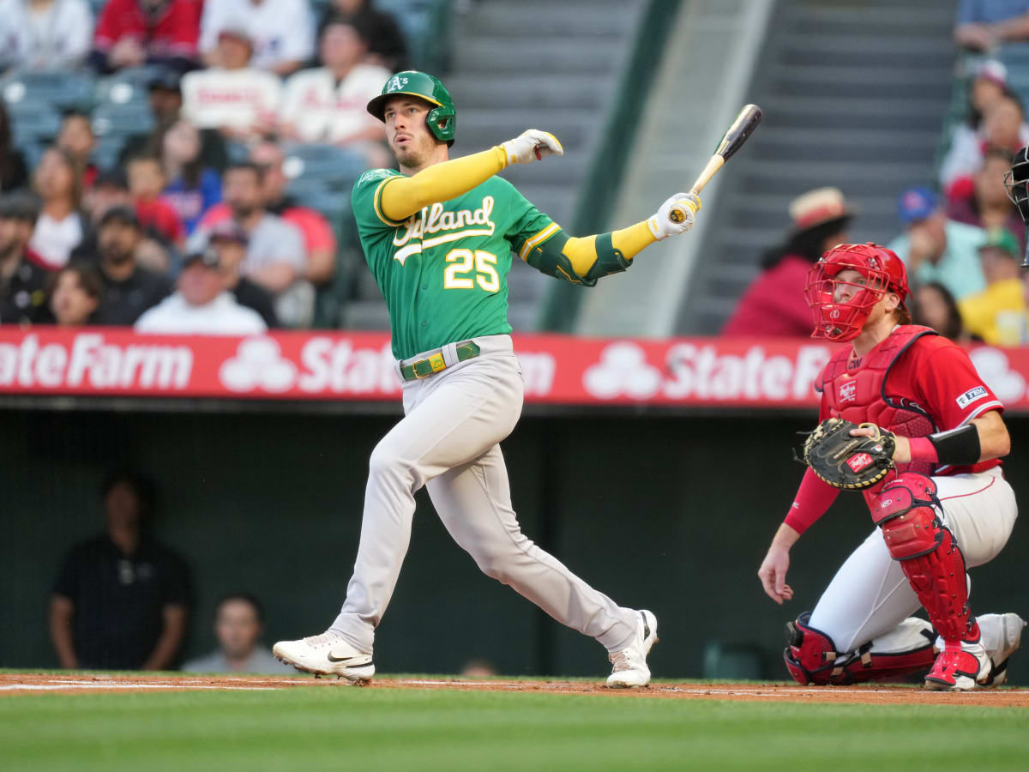
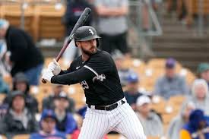
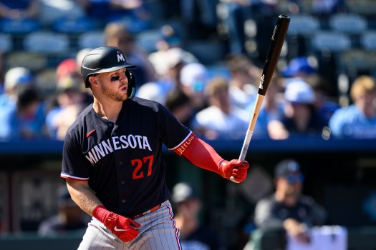
Hitters
Brent Rooker, Oakland Athletics
Paul DeJong, Chicago White Sox
Ryan Jeffers, Minnesota Twins

Slide 20
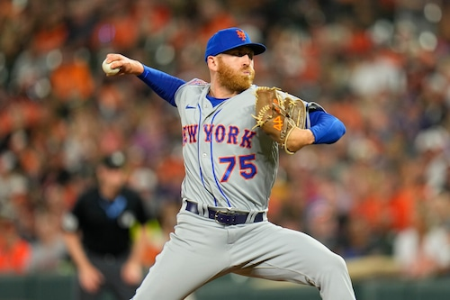
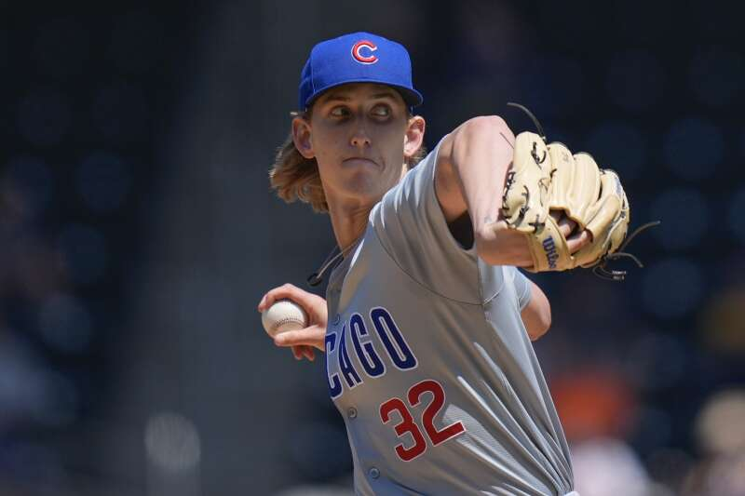
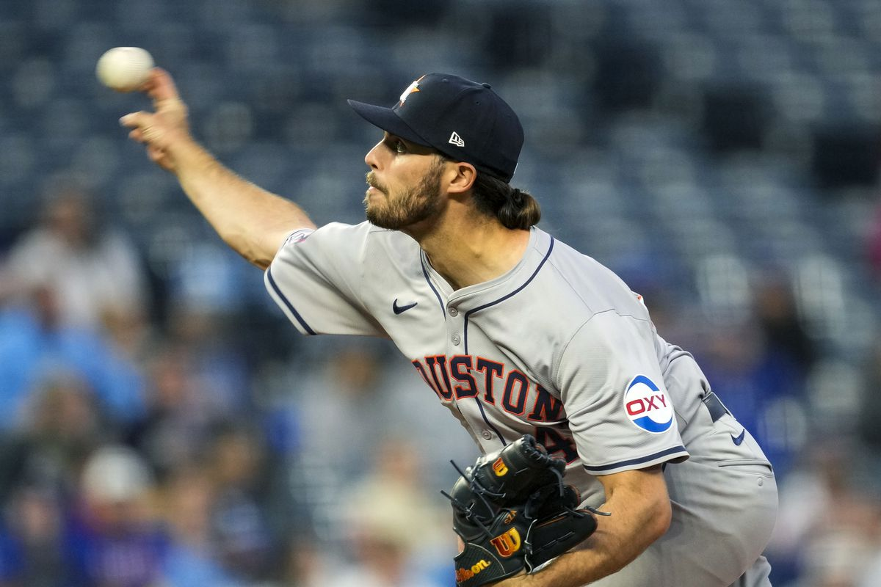
Pitchers
Reed Garrett, New York Mets
Ben Brown, Chicago Cubs
Spencer Arrighetti, Houston Astros

Slide 21
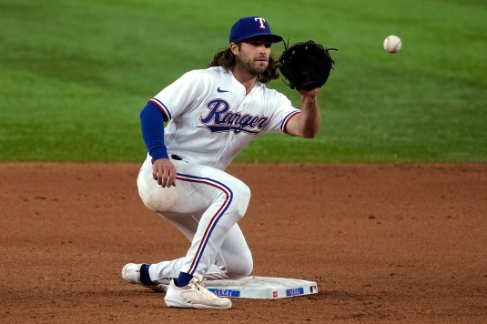
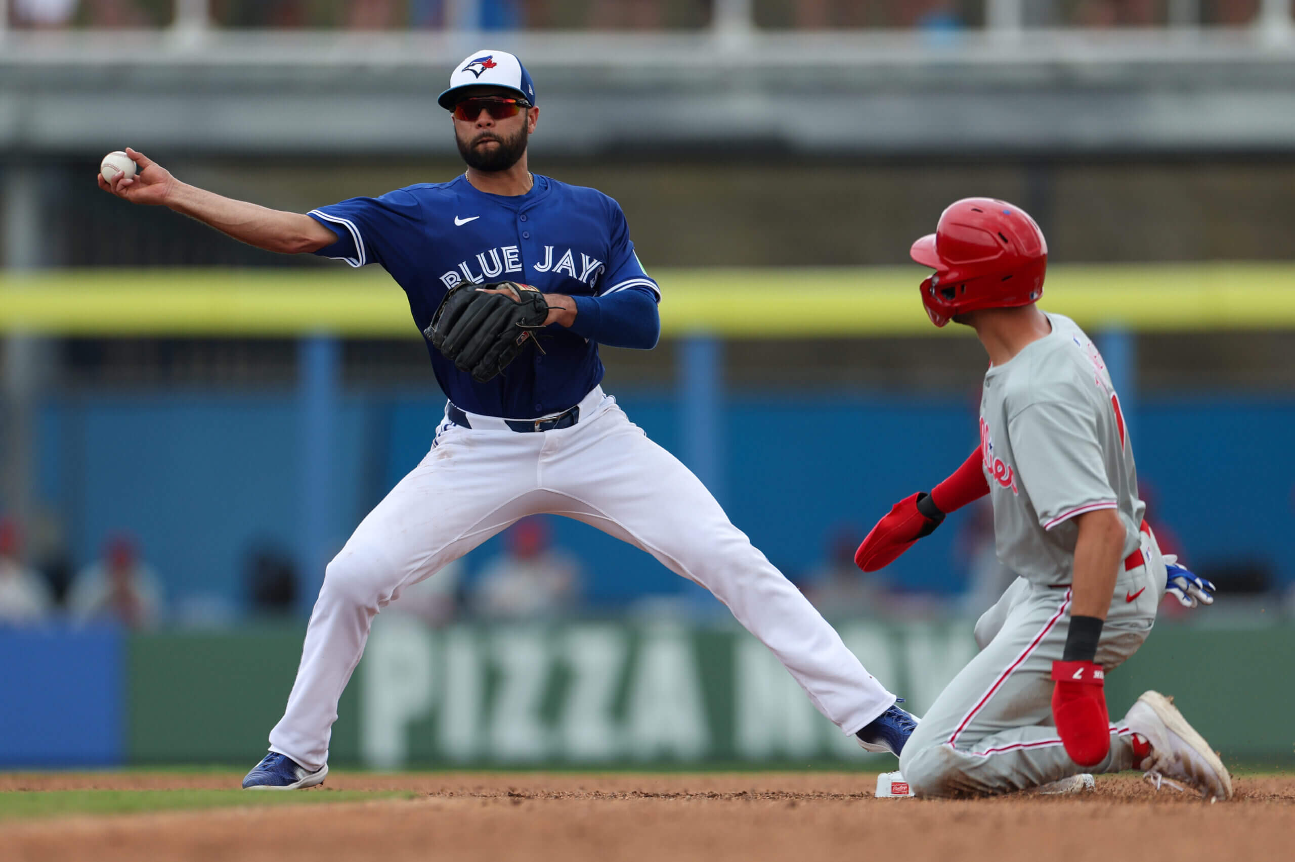
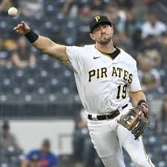
Fielders
Josh Smith, Texas Rangers
Jared Triolo, Pittsburgh Pirates
Isiah Kiner-Falefa, Toronto Blue Jays

Slide 22

Benefits
While these findings and the proposed actions may help a team realize playoff success, specific quantitative measures of any benefits are impossible to predict from hypothesis testing alone. With that said, the potential benefits of utilizing these results in roster construction are as follows:
Greater probability of playoff success, including winning the World Series.
Increased fan support, media coverage, and tickets/merchandising revenue.
Higher interest from other players and coaches to join the team.

Slide 23
Source
This analysis was performed utilizing data from the Lahman Baseball Database.
This database is described as containing “complete batting and pitching statistics from 1871 to 2023, plus fielding statistics, standings, team stats, managerial records, post-season data, and more.”
This quotation and the database were retrieved from seanlahman.com.

